Slide 1

Garland Independent
School District
2024 – 2025
Rating Presentation
(Fiscal Year 2023-2024 Data)

Slide 2

Purpose
Expands the public education accountability system in Texas to the Financial Services.
Originated by SB875 of the 76th Texas Legislature in 1999.
Primary goal to improve management of school district’s financial resources.

Slide 3
Objectives
Assess the quality of financial management in Texas public schools.
Measure and report the extent to which financial resources are allocated for direct instructional purposes.
Fairly evaluate the quality of financial management decisions.
Openly report results to the general public.

Slide 4
Ratings
HB 5 of the 83rd Texas Legislature in 2013 required the Commissioner of Education to include indicators in FIRST to anticipate the future financial solvency of districts.
The 2024-2025 rating is determined by the scores on 21 indicators.
  A = Superior Achievement 90 - 100
  B = Above Standard Achievement 80 - 89
  C = Meets Standard Achievement 70 - 79
  F = Substandard Achievement <70
Notes:
The questions are all designed so that a no answer is bad. It makes the questions a little hard to follow.

Slide 5
How Ratings Are Assessed
Was the complete annual financial report (AFR) and data submitted to the TEA within 30 days of the November 27 or January 28 deadline depending on the school district’s fiscal year end date of June 30 or August 31, respectively? YES
Was there an unmodified opinion in the AFR on the financial statements as a whole? YES
Was the school district in compliance with the payment terms of all debt agreements at fiscal year end? YES

Slide 6
How Ratings Are Assessed
Did the school district make timely payments to the Teachers Retirement System (TRS), Texas Workforce Commission (TWC), Internal Revenue Service (IRS), and other government agencies? YES, Ceiling Passed
Was the total net position balance in the governmental activities column in the Statement of Net Position (net of accretion of interest for capital appreciation bonds, net pension liability, and other post-employment benefits) greater than zero? YES, Ceiling Passed
Notes:
Have we defaulted on our debt?
Did we file our audit report on time?

Slide 7
How Ratings Are Assessed
Was the average change in (assigned and unassigned) fund balance over 3 years less than a 25% decrease or did the current year assigned and unassigned fund balance exceed 75 days of operational expenditures? Ceiling Passed
Was the number of days of cash on hand and current investments in the general fund for the school district sufficient to cover operating expenditures (excluding facilities acquisition and construction)? 10
Notes:
Have we defaulted on our debt?
Did we file our audit report on time?

Slide 8
How Ratings Are Assessed
Was the measure of current assets to current liabilities ratio for the school district sufficient to cover short-term debt? 10
Did the school district’s general fund revenues equal or exceed expenditures (excluding facilities acquisition and construction)? If not, was the school district’s number of days of cash on hand greater than or equal to 60 days? 10
Notes:
Does the peims data match the audit report?
Were tax supported debt expenditures less than $770 per student?

Slide 9
How Ratings Are Assessed
Did the school district average less than a 10 percent variance (90% to 110%) when comparing budgeted revenues to actual revenues for the last 3 fiscal years? This indicator paused for the 2024-2025 rating. Its being paused since the 2021-2022 rating.
Was the ratio of long-term liabilities to total assets for the school district sufficient to support long-term solvency? 10
What is the correlation between future debt requirements and the district’s assessed property value? 10
Notes:
Does the peims data match the audit report?
Were tax supported debt expenditures less than $770 per student?

Slide 10
How Ratings Are Assessed
13. Was the school district’s administrative cost ratio equal to or less than the threshold ratio?
7.49% 10 of 10 points
sum of amounts for
function codes 21 and 41
Administrative
Cost
Ratio
sum of amounts for function
codes 11, 12, 13, and 31
21-Instructional Leadership 11-Instruction
41-General Administration 12-Instructional Resources and Media Services
13-Curriculum and Instructional Staff Development
31-Guidance, Counseling and Evaluation Services
Prior year district administrative cost ration was 7.71%, two years ago the ratio was 6.92%
Only payroll (excluding TRS On-Behalf), professional and contracted services, supplies and materials, other operating costs
are used in the calculation of the administrative cost ratio.
Notes:
Have we defaulted on our debt?
Did we file our audit report on time?

Slide 11
How Ratings Are Assessed
Did the school district not have a 15 percent decline in the students to staff ratio over 3 years (total enrollment to total staff)? 10
Was the school district's ADA within the allotted range of the district's biennial pupil projection(s) submitted to TEA? 5
Did the comparison of Public Education Information Management System (PEIMS) data to like information in the school district’s AFR result in a total variance of less than 3 percent of all expenditures by function? Ceiling Passed
Notes:
Does the peims data match the audit report?
Were tax supported debt expenditures less than $770 per student?

Slide 12
How Ratings Are Assessed
Did the external independent auditor report that the AFR was free of any instance(s) of material weaknesses in internal controls over financial reporting and compliance for local, state, federal funds and free from substantial doubt about the school district’s ability to continue as a going concern? Ceiling Passed
Did the external independent auditor indicate the AFR was free of any instance(s) of material noncompliance for grants, contracts, and laws related to local, state, or federal funds? 10
Did the school district post the required financial information on its website in accordance with Government Code, Local Government Code, Texas Education Code, Texas Administrative Code and other statutes, laws and rules that were in effect at the school district's fiscal year end? 5
Did the school district’s administration and school board members discuss any changes and/or impact to local, state, and federal funding at a board meeting within 120 days before the district adopted its budget? Ceiling Passed
Notes:
Does the peims data match the audit report?
Were tax supported debt expenditures less than $770 per student?

Slide 13
How Ratings Are Assessed
Did the school district receive an adjusted repayment schedule for more than one fiscal year for an overallocation of Foundation School Program (FSP) funds because of a financial hardship? Ceiling Passed
Notes:
Does the peims data match the audit report?
Were tax supported debt expenditures less than $770 per student?

Slide 14
What is GISD’s Rating?
A = Superior Achievement
  GISD received a YES or the maximum points on all indicators.
  The district received the highest rating possible as established under guidelines and rules established by the Texas Education Agency.

Slide 15
Required Disclosures
Superintendent’s Current Contract
https://garlandisd.net/about/financial-information

Slide 16
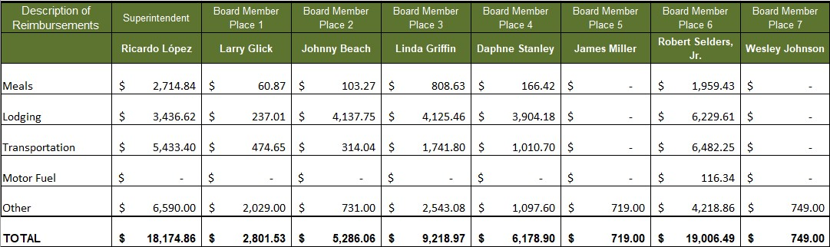
Required Disclosures
Reimbursements Received by the Superintendent and Board Members for Fiscal Year 2024
For the Twelve-month Period Ended June 30, 2024

Slide 17
Required Disclosures
Outside compensation and/or fees received by the Superintendent for professional consulting and/or other personal services in fiscal year 2024.
None

Slide 18
Required Disclosures
Gifts received by the Executive Officer(s) and Board Members (and first degree relatives, if any) in fiscal year 2024.
None

Slide 19
Required Disclosures
Business transactions between the District and Board Members for fiscal year 2024.
None

