Slide 1
Linking Khan Academy and College Board
Student Accounts

Slide 2
Why link Khan Academy and
College Board Accounts?
Linking your accounts will further personalize your practice: the practice recommendations on Khan Academy will be based on your PSAT/NMSQT results
All future scores from the SAT, PSAT/NMSQT, PSAT 10 and PSAT 8/9
will also be sent to help customize your practice and recommendations on
Khan Academy.
You will be able to jump right into practice without having to take any additional diagnostic quizzes or practice tests to get personalized recommendations.
Please note that you can terminate your account linking at any time.

Slide 3
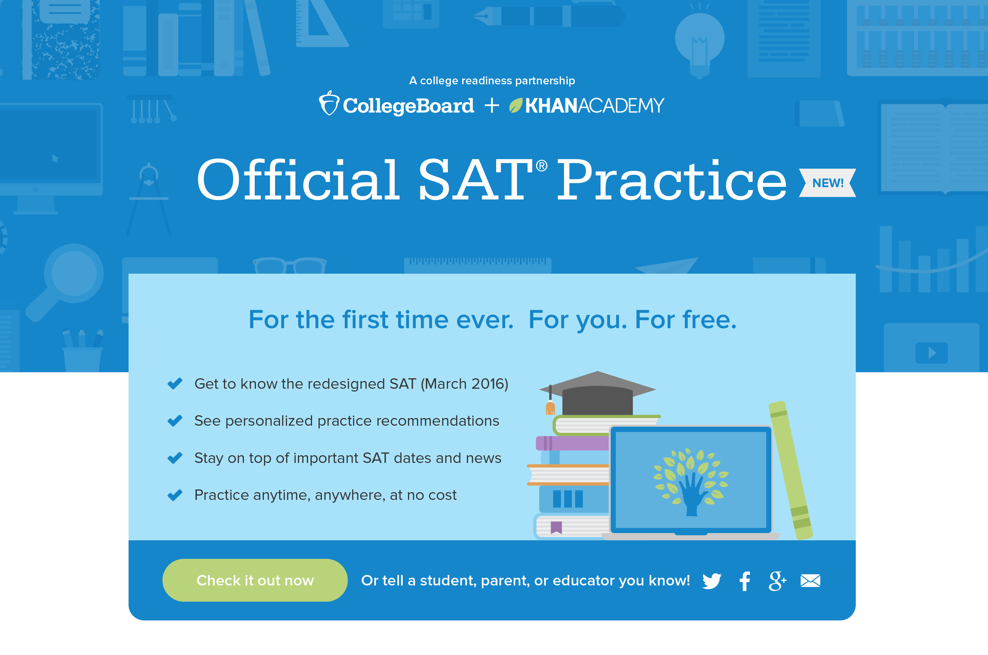
Steps to link your College Board and Khan Academy Accounts
Step 1
Log in your
Khan Academy account at https://readyhub.garlandisd.net using “s+ID” for your username and your NPIN for your password.
Click on Khan Academy. If you are asked if you have an account, select “No, I need to create a new Khan Academy account.”
If asked for an e-mail, select “Not now.”
Notes:
Alternate text for screen shot:
A screen shot is titled: Official SAT Practice NEW! A subhead reads For the first time ever. For you. For free. There are four bullet points: Get to know the redesigned SAT (March 2016); See personalized practice recommendations; Stay on top of important SAT dates and news; Practice anytime, anywhere, at no cost.

Slide 4
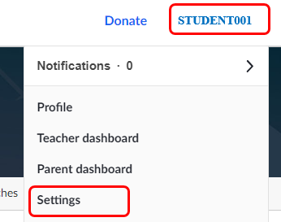
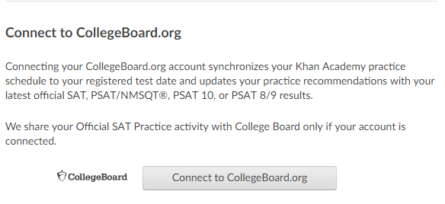
Steps to link your College Board and Khan Academy Accounts
Step 2
On Khan homepage, select name at the top right of screen. Then select “Settings.”
Scroll down and select “Connect to CollegeBoard.org” to sign in or create your
College Board Account.
Notes:
Alternate text for screen shot:
A screen shot is titled: Official SAT Practice NEW! A subhead reads For the first time ever. For you. For free. There are four bullet points: Get to know the redesigned SAT (March 2016); See personalized practice recommendations; Stay on top of important SAT dates and news; Practice anytime, anywhere, at no cost.

Slide 5
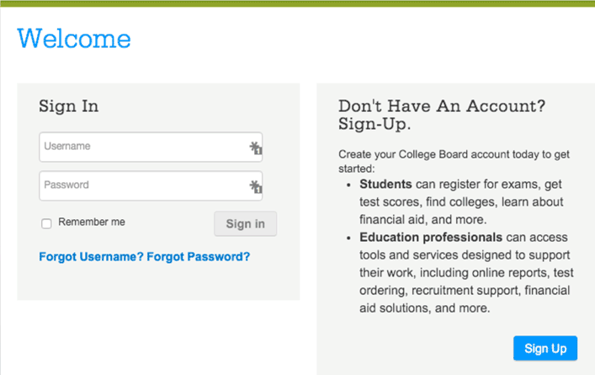
Step 3:
Create a College Board Account
Sign in to your College Board account; if you do not have a
College Board account, click
'Sign Up' to create one.
The steps for creating a
College Board account are:
  Click on the “Sign up” blue box
  Fill in the fields to create your
  student account ensuring all information is correct
  WRITE DOWN (or record on your phone) the user name and password that you select. You will be logging in to College Board many times in the future.
  Click “Next” at the bottom
  when all fields are completed
  You are now Signed In
Please note that students under 13 cannot create a College Board Account. However, they can still use Khan Academy SAT practice and can create a College Board Account when the student is 13.
Notes:
A screen shot shows to fillable boxes a user must fill in to create a College Board Account: username and password. A remember me box may be clicked. A side note advises Students can register for exams, get test scores, find colleges, learn about financial aid and more. Education professionals can access tools and services designed to support their work, including online reports, test ordering, recruitment support, financial aid solutions and more.

Slide 6
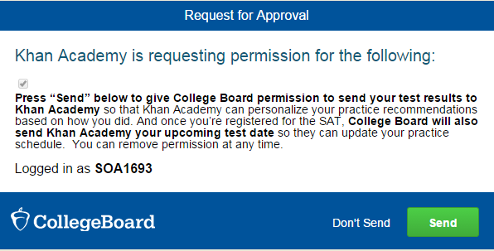
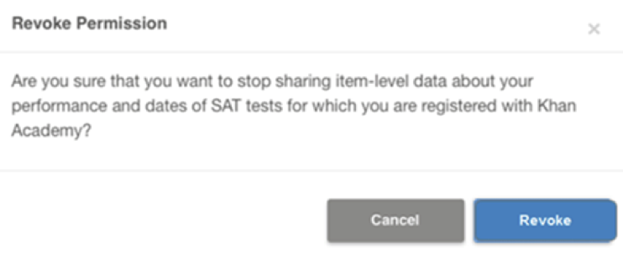
Step 3:
And Hit Send to Link Accounts
After successfully logging in to your College Board account,
you will be asked for permission to link your accounts.
After clicking “Send” you will
be redirected to SAT practice
on the Khan Academy site.
You can remove the link at
any time, by clicking on
“Revoke” which is found in College Board account settings.
Notes:
A screen shot is titled Request for Approval: Khan Academy is requesting permission for the following: Press send below to give College Board permission to send your test results to Khan Academy so that Khan Academy can personalize your practice recommendations based on how you did. And once you’re registered for the SAT College Board will also send Khan Academy your upcoming test dates so they can update your practice schedule. You can remove permission at any time. A green send button is highlighted. Below is a step titled Revoke Permission. Clicking on the blue button labeled Revoke will do so.

Slide 7
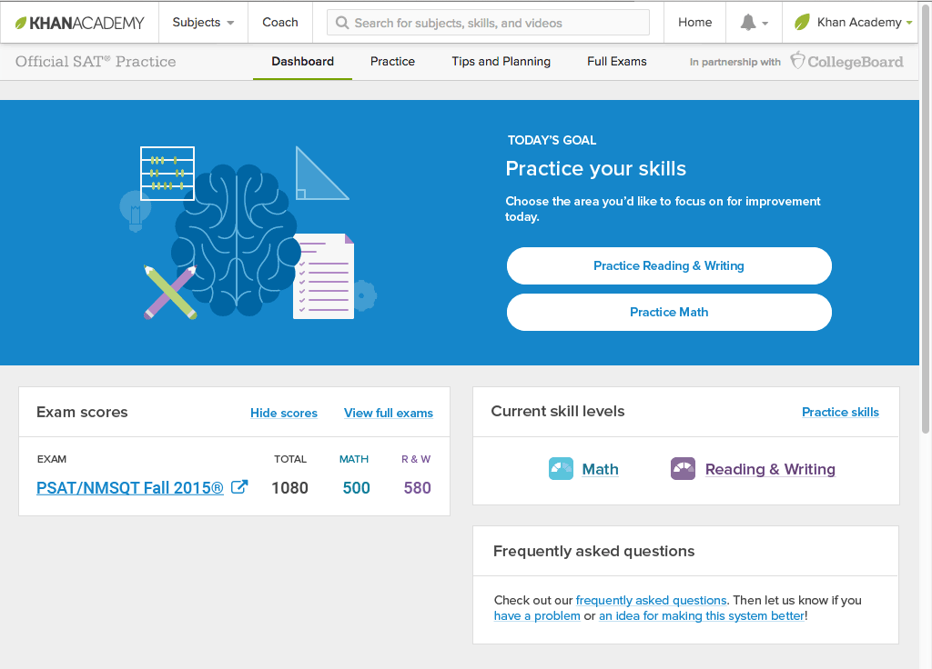
Now Start Practicing on Khan Academy with Personalized Recommendations
You can start your practice in either Math or Evidence Based Reading & Writing.
The recommendations
are based on how you did on the PSAT/NMSQT or PSAT 8/9.
Keep practicing –
with each additional problem and activity
the personalization gets stronger and gets you closer to your goal
score on the SAT,
PSAT/NMSQT, PSAT 10,
or PSAT 8/9.
Notes:
A screen grab is titled Today’s Goal: Practice your skills. Users may click on Reading & Writing or Practice Math to begin their practice. A sample combined score of 1080 is shown: 500 for math; 580 for reading and writing. A section called current skill levels is shown as is frequently asked questions.

